Slide 1
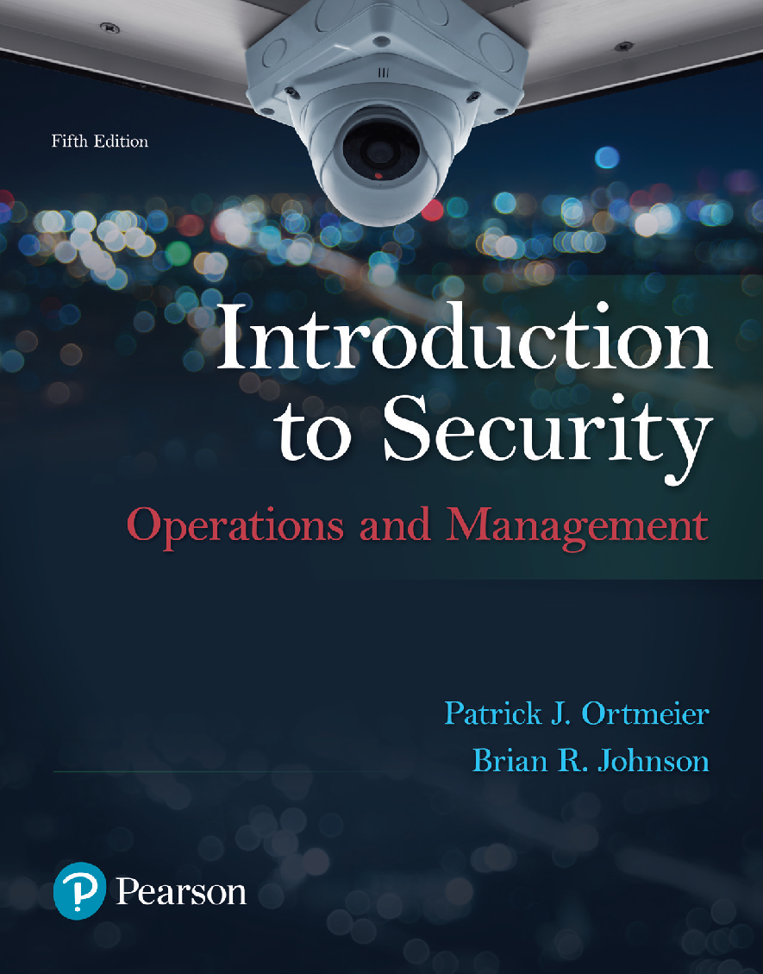
Introduction to Security: Operations & Management
5th Edition
Chapter 9
Homeland Security

Slide 2
Learning Objectives (1 of 2)
After completing this chapter, the reader should be able to:
1. Explain the concept and philosophy of homeland security
2. Identify security threats unique to homeland security
3. Understand the role and findings of the 9-11 Commission
4. Explain the main components of the USA PATRIOT Act
5. Describe the structure, mission, and agendas of the Department of Homeland Security (DHS)
Notes:
Slide 2 is list of textbook LO numbers and statements

Slide 3
Learning Objectives (2 of 2)
6. Explain the functions of homeland security
7. Describe government and private sector responsibilities, especially as they relate to the DHS and the philosophy of homeland security
8. Explain the role of the private sector in homeland security
9. Explain the NIPP and NIMS programs
10. Articulate some of the key elements of securing airlines, airports, and ground transportation systems (critical infrastructure)
Notes:
Slide 2 is list of textbook LO numbers and statements

Slide 4
Homeland Security: A Historical Perspective (1 of 3)
The US Constitution & Homeland Security:
The evolution of Homeland Security:

Slide 5
9-11 & Homeland Security (1 of 2)
National Commission on Terrorist Attacks Upon the United States (2002):
  Tasks/Responsibilities
  Recommendations

Slide 6
9-11 & Homeland Security (2 of 2)
Intelligence Reform & Terrorism Prevention Act of 2004:
Implementing Recommendations of the 9-11 Commission Act of 2007:

Slide 7
USA PATRIOT Act (1 of 2)
Uniting and Strengthening American by Providing Appropriate Tools Required to Intercept and Obstruct Terrorism (2001):
Key Elements:

Slide 8
USA PATRIOT Act (1 of 2)
USA PATRIOT Improvement and Reauthorization Act of 2005:
Uniting and Strengthening American by Fulfilling Rights and Ensuring effective Discipline Over Monitoring Act of 2015:

Slide 9
The Department of Homeland Security (1 of 3)
Background:
Six point agenda:
  1
  2
  3
  4
  5
  6

Slide 10
The Department of Homeland Security (2 of 3)
DHS main components:
Agencies housed under the DHS include:

Slide 11
The Department of Homeland Security (3 of 3)
Advisory panels & committees:
Function & mission:

Slide 12
The Role of the Private Sector in Homeland Security (1 of 2)
National Infrastructure Protection Plan (NIPP):
  Goal/Purpose:
  Key elements of NIPP:

Slide 13
The Role of the Private Sector in Homeland Security (2 of 2)
National Incident Management System (NIMS):
  Goal/Purpose
  Key points
  Five main components

Slide 14
Terrorism & Homeland Security (1 of 2)
Terrorism Defined:
International Terrorism:
Domestic Terrorism:

Slide 15
Terrorism & Homeland Security (2 of 2)
Nationwide Suspicious Activity Reporting System :
Bioterrorism Act of 2002:

Slide 16
Homeland Security: Natural, Technological & Accidental Hazards (1 of 2)
Introduction/Definitions:
Post-Katrina Emergency Reform Act of 2006:
  Key Points
  Primary Goals in Disaster Management include:

Slide 17
Homeland Security: Natural, Technological & Accidental Hazards (2 of 2)
Public health issues:
Food safety related issues:

Slide 18
Transportation Security (1 of 4)
Introduction/Definition:
Aviation security:
  History & evolution

Slide 19
Transportation Security (2 of 4)
The Transportation Security Administration:
Strategies for Passenger Screening & Explosives Detection:

Slide 20
Transportation Security (3 of 4)
Trucking industry security:
Railroad security:

Slide 21
Transportation Security (4 of 4)
Maritime security:

